Slide 1
Association Rule Mining - I
Lecture 14

Slide 2
Learning Objectives
After the completion of today’s lesson students will be able to:
Discuss the importance of association rule mining.
Calculate the interestingness of association rules.
Analyze the transactions in a database to find out the frequent itemsets.

Slide 3
Agenda
Association rule mining
Interestingness measure in association rule mining
Mining single dimensional association rules from transactional database

Slide 4
Association Rule Mining
Given a set of transactions, find rules that will predict the occurrence of an item based on the occurrences of other items in the transaction
Market-Basket transactions
Example of Association Rules
{Diaper} → {Beer}, {Milk, Bread} → {Eggs,Coke}, {Beer, Bread} → {Milk},
Implication means co-occurrence, not causality!

Slide 5
Definitions:
Itemset
A collection of one or more items
Example: {Milk, Bread, Diaper}
k-itemset
An itemset that contains k items
Frequency/Support Count/Count/Absolute Support
Frequency of occurrence of an itemset
E.g. σ{Milk, Bread,Diaper} = 2
Support
Fraction of transactions that contain an itemset
E.g. s({Milk, Bread, Diaper}) = 2/5
Frequent Itemset
An itemset whose support is greater than or equal to a min_sup threshold

Slide 6
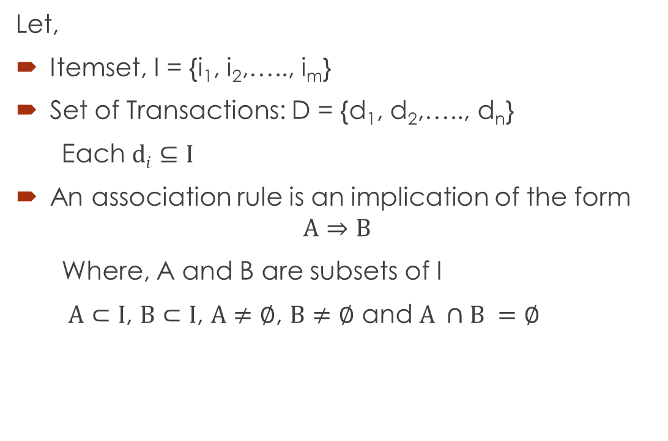
Association Rules
Let,
Itemset, I = {i₁, i₂,….., i_{m}}
Set of Transactions: D = {d₁, d₂,….., d_{n}}
Each $di⊆I$
An association rule is an implication of the form
$$A⇒B$$
Where, A and B are subsets of I
$A⊂I$, $B⊂I$, $A≠∅$, $B≠∅$ and $A ∩B =∅$

Slide 7
Agenda
Association rule mining
Interestingness measure in association rule mining
Mining single dimensional association rules from transactional database

Slide 8
Measure of interestingness of Association Rule
The measurement of interestingness for association rules
Support(relative support), s, probability that a transaction contains A∪B
s = support(“A⇒B”) = P(A∪B)
confidence, c, conditional probability that a transaction having A also contains B.
c = confidence(“A⇒B”)
= P(B|A)
= support(A∪B)/support(A)
Note: Rules that satisfy both a minimum support threshold (min_sup) and a minimum confidence threshold (min_conf ) are called strong.

Slide 9
Support and confidence calculation
Example of Rule:
{Milk,Diaper} → {Beer} (s=0.4, c=0.67)
Example:

Slide 10
Support and confidence calculation
Example of Rules:
{Milk,Beer} → {Diaper} (s=0.4, c=1.0)
{Diaper,Beer} → {Milk} (s=0.4, c=0.67)
{Beer} → {Milk,Diaper} (s=0.4, c=0.67)
{Diaper} → {Milk,Beer} (s=0.4, c=0.5)
{Milk} → {Diaper,Beer} (s=0.4, c=0.5)

Slide 11
Support and confidence calculation
Example of Rules:
{Milk,Beer} → {Diaper} (s=?, c=?)
{Diaper,Beer} → {Milk} (s=?, c=?)
{Beer} → {Milk,Diaper} (s=?, c=?)
{Diaper} → {Milk,Beer} (s=?, c=?)
{Milk} → {Diaper,Beer} (s=?, c=?)

Slide 12
Association Rule mining task
Given a set of transactions T, the goal of association rule mining is to find all rules having
support ≥ minsup threshold
confidence ≥ minconf threshold

Slide 13
Association Rules mining process
Two-step approach:
Frequent Itemset Generation
Generate all itemsets whose support ≥ min_sup
Generate strong association rules from the frequent itemsets:
Rules must satisfy min_sup and min_conf

Slide 14
Agenda
Association rule mining
Interestingness measure in association rule mining
Mining single dimensional association rules from transactional database

Slide 15
The Apriori Algorithm
The name, Apriori, is based on the fact that the algorithm uses prior knowledge of frequent itemset properties
Apriori employs an iterative approach known as a level-wise search, where k-itemsets are used to explore (k+1)-itemsets
The first pass determines the frequent 1-itemsets denoted L1
A subsequence pass k consists of two phases
First, the frequent itemsets L_{k-1} are used to generate the candidate itemsets C_{k}
Next, the database is scanned and the support of candidates in C_{k} is counted
The frequent itemsets L_{k} are determined

Slide 16
Apriori Property
Apriori property: any subset of a large itemset must be large
If {beer, diaper, nuts} is frequent, so is {beer, diaper}
Every transaction having {beer, diaper, nuts} also contains {beer, diaper}
Anti-monotone: if a set cannot pass a test, all of its supersets will fail the same test as well

Slide 17
Apriori: A Candidate Generation-and-test Approach
Apriori pruning principle: If there is any itemset which is infrequent, its superset should not be generated/tested!
Method: join and prune steps
Generate candidate (k+1)-itemsets C_{k+1} from frequent k-itemsets L_{k}
If any k-subset of a candidate (k+1)-itemset is not in L_{k}, then the candidate cannot be frequent either and so can be removed from C_{k}
Test the candidates against DB to obtain L_{k+1}

Slide 18
The Apriori Algorithm
C_{k}: Candidate itemset of size k
L_{k} : frequent itemset of size k
L₁ = {frequent items};
for (k = 1; L_{k} !=∅; k++) do begin
C_{k+1} = candidates generated from L_{k};
for each transaction t in database do
increment the count of all candidates in C_{k+1} that are contained in t
L_{k+1} = candidates in C_{k+1} with min_support
end
return U_{k} L_{k} ;

Slide 19
Example
Find the frequent itemsets in the following database D with min_sup count = 2
TID | List of item IDs
T1 | A,B,E
T2 | B,D
T3 | B,C
T4 | A,B,D
T5 | A,C
T6 | B,C
T7 | A,C
T8 | A,B,C,E
T9 | A,B,C

Slide 20
Challenges of frequent pattern mining
Challenges
Multiple scans of transaction database
Huge number of candidates
Tedious workload of support counting for candidates
Improving Apriori: general ideas
Reduce passes of transaction database scans
Shrink number of candidates
Facilitate support counting of candidates

Slide 21
Summary
Given a set of transactions, find rules that will predict the occurrence of an item based on the occurrences of other items in the transaction
Support and confidence are the two main interestingness measure of association rules
Apriori algorithm is used for mining frequent itemsets for Boolean association rules.

Slide 22
References
[1] Hiawei Han, MichelineKamber,“Data Mining: Concepts and Techniques”, Morgan Kaufmann Publishers editor, 2006.

Slide 23
Thanks

